Slide 1
EARTH & SPACE
REVIEW

Slide 2
A student claims that the arrangement of planets in our Solar System is random. Using your understanding of planetary types, what reasoning best challenges this claim?
A. Terrestrial planets are smaller because they formed closer to the Sun, where temperatures were lower.
B. Jovian planets are larger because they are closer to the asteroid belt, which provided extra material.
C. Jovian planets are gaseous because they formed after the Sun’s radiation removed gas from the inner planets in the early formation of the solar system.
D. Terrestrial planets are rocky and found closer to the Sun. In contrast, Jovian planets are gaseous and found farther away due to temperature and material differences in the early Solar System.
gag

Slide 3
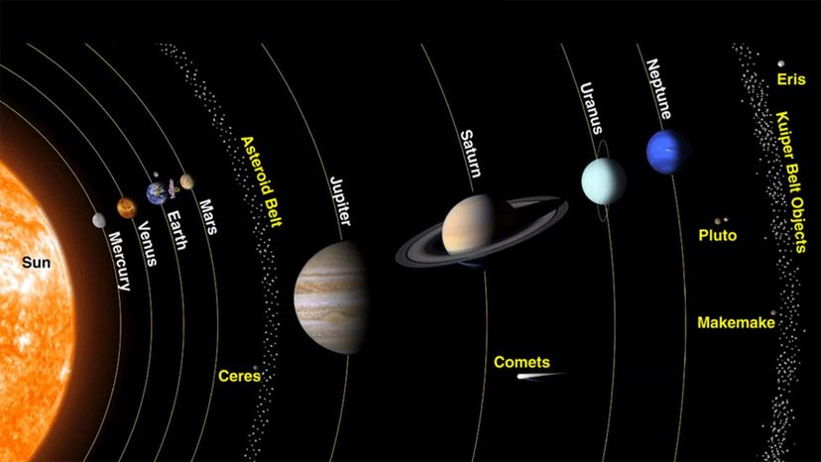

Slide 4
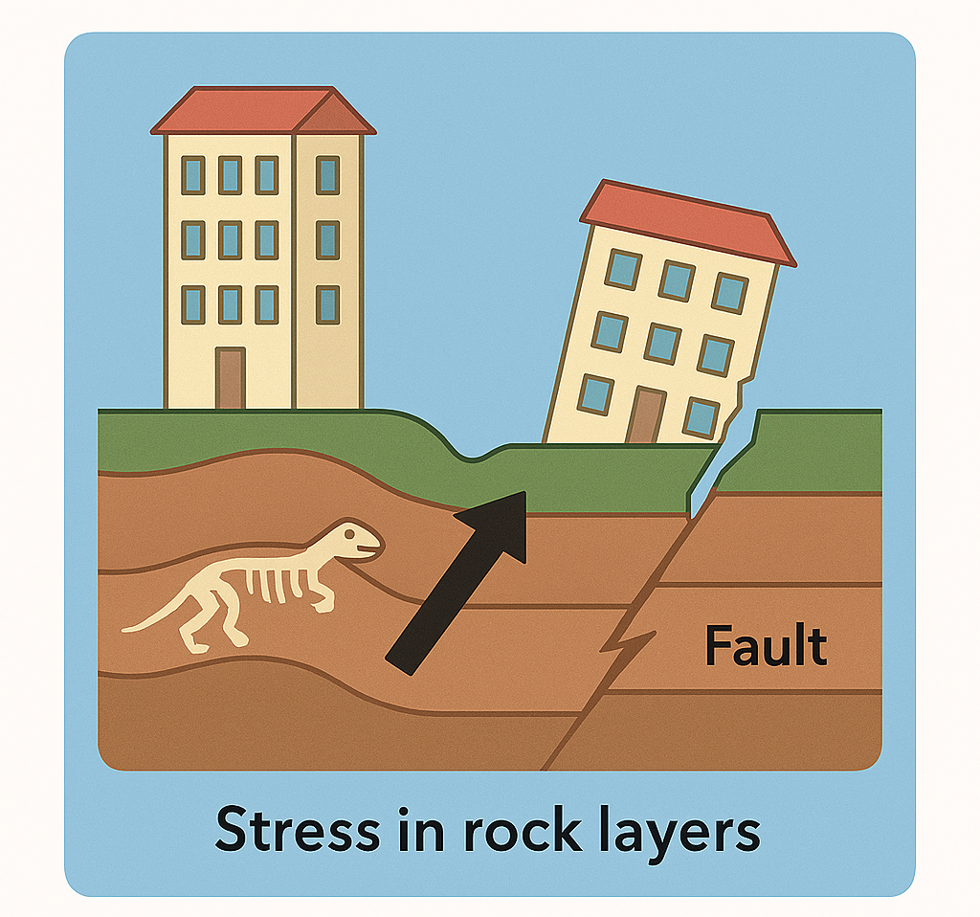
How does the movement of tectonic plates lead to the formation of folds and faults in Earth’s crust?
A. The plates remain stationary, and folds form only from volcanic activity. B. The plates sink directly into the mantle without affecting rock layers above.
C. The plates push, pull, or slide past each other, causing rock layers to bend or break. D. The plates heat evenly, making rocks expand without bending or breaking.
gag

Slide 5
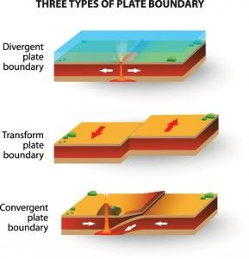

Slide 6
During a science lab, three students debated about a mineral sample. If you analyze their statements, which property is Carlo describing? Student A: Anna says it’s identified by how it splits into flat surfaces. Student B: Ben says it’s about how shiny it looks. Student C: Carlo says it’s about how difficult it is to scratch
gag
A. Cleavage C. Hardness B. Fracture D. Luster

Slide 7
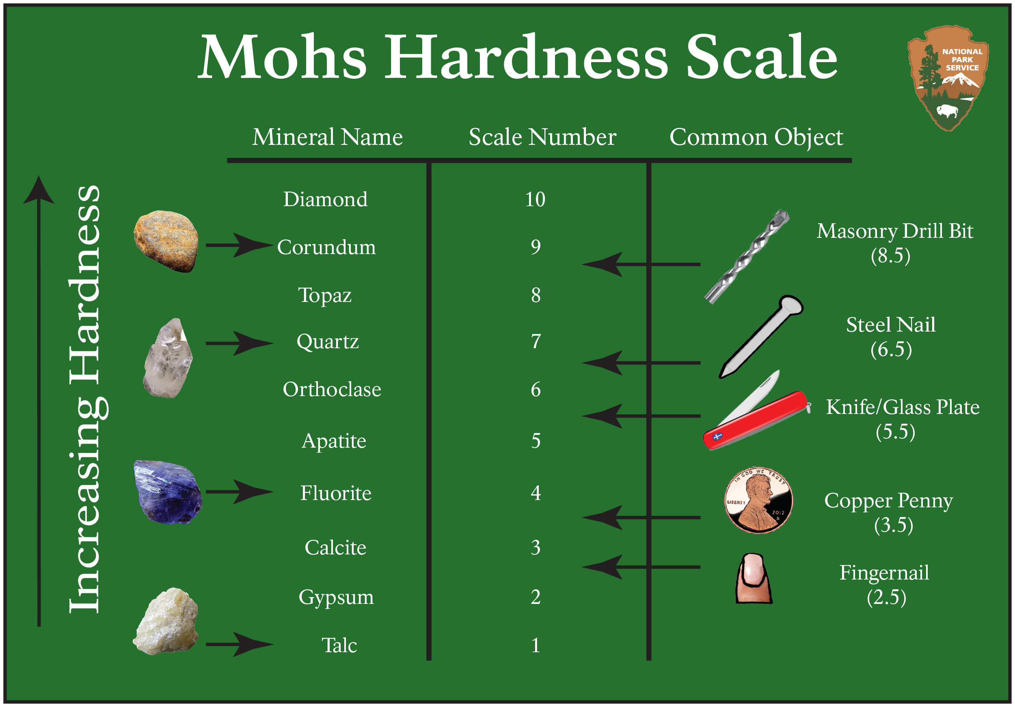
PROPERTIES OF MINERALS

Slide 8
A research team is designing a drill capable of withstanding extreme heat and pressure to collect samples from the layer beneath the crust but above the core. Which layer should the drill be built for?
gag
gag
Crust B. Mantle
C. Outer Core D. Inner Core

Slide 9
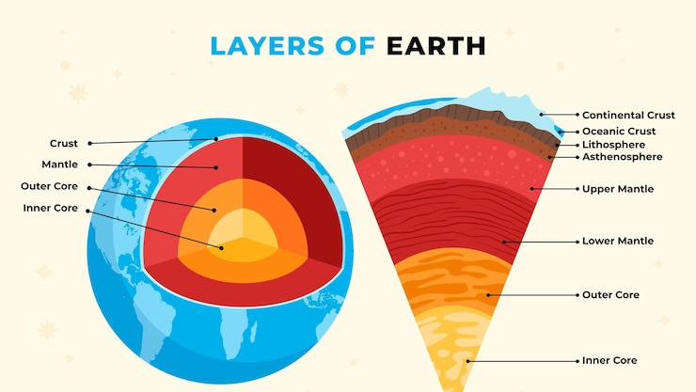

Slide 10
What can you infer about graphite from the fact that you can scratch it with just your fingernail?
gag
gag
A. It has a fracture C. It is not very lustrous
B. It is not very hard D. Its streak is black-colored
gag

Slide 11


Slide 12
A team of scientists is deciding how to allocate limited funding for space exploration. Based on the most recent advancements and discoveries about the solar system, which of the following projects would likely yield the greatest contribution to understanding planetary habitability? A. Building a permanent lunar base to study the Moon’s geology and its potential for resource extraction. B. Expanding the Mars Sample Return mission to include deeper subsurface drilling for possible microbial life. C. Sending a probe to study the surface of Mercury and Venus for more clues about early planetary formation. D. Increasing the frequency of asteroid flyby missions is better for tracking potential Earth impact threats from cosmic objects.
gag
gag

Slide 13
In a science quiz, students are given this clue: a molten substance located beneath the Earth’s surface, composed of elements like silicon, aluminum, iron, and oxygen; containing 45–75% silica by weight; and melting at temperatures between 800–1400 °C. Which term correctly identifies this substance? A. Basalt, a type of solid volcanic rock rich in iron and magnesium B. Lava, the molten rock that has already erupted and reached the Earth’s surface C. Granite, a coarse-grained igneous rock that forms when magma cools slowly underground D. Magma, the molten rock beneath the Earth’s surface, contains silica and other abundant elements
gag
gag
gag
gag

Slide 14
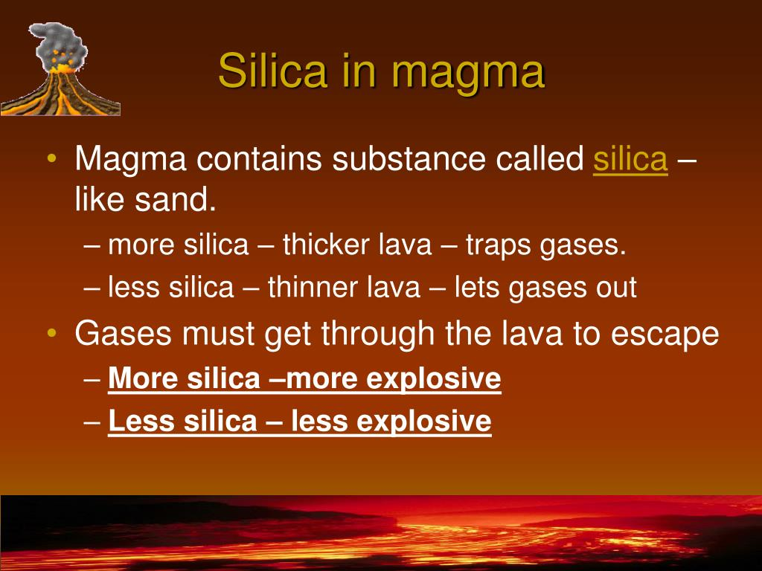

Slide 15
How would you explain the process of seafloor spreading at divergent boundaries to create a model that shows how new oceanic crust forms and shapes the seafloor? A) Plates remain still, and underwater mountains develop only from accumulated sediments. B) Plates collide, forcing magma upward to fold and uplift the ocean floor, forming mountains. C) Plates slide past each other, generating friction that melts rock and forms new crust along faults. D) Plates move apart, magma rises and cools to form new crust, pushing the seafloor outward and creating underwater features.
gag
gag

Slide 17
How do the movements of tectonic plates around the Pacific Ring of Fire, especially near the Philippines, cause the formation of folds and faults in the Earth’s crust? A) The Pacific Plate moves away from the Philippine Plate at divergent boundaries, creating compressional folds and reverse faults that form mountain ranges in the Philippines. B) The Pacific Plate and Philippine Plate slide past each other along transform boundaries, producing tensional normal faults and volcanic eruptions common in the Philippines. C) The Pacific Plate converges with the Philippine Plate, causing compressional forces that create folds and reverse faults, leading to earthquakes and volcanic activity in the Philippines. D) The plates remain mostly stationary in the Pacific Ring of Fire, causing only minor horizontal folding and no significant fault formation near the Philippines.
gag

Slide 18
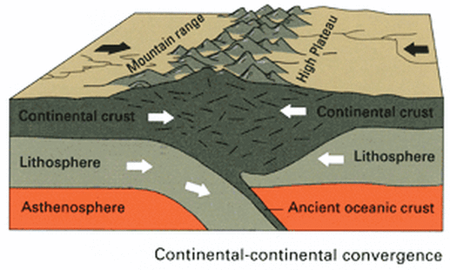

Slide 19


Slide 20
What theory explains the expansion of the universe for a time and then contracting due to the pull of its gravity, in a perpetual cycle of Big Bang followed by Big Crunch?
gag
A. Steady State Theory C. Big Bang Theory
B. Oscillating Universe D. Inflationary Universe
gag

Slide 21
Which of the following best describes the type of evidence scientists use to support the Big Bang Theory?
A. Variations in planets' orbits in our solar system
B. Abundance of heavy elements in the outer space.
C. Seasonal changes in the brightness of nearby stars.
D. Measurements of cosmic microwave background radiation
gag

Slide 22
A student collected data on several galaxies and plotted their distances from Earth against their observed redshift values. Using Edwin Hubble’s discovery, how should the student interpret the trend in the graph?
A. Galaxies with higher redshift are moving toward Earth faster.
B. Galaxies with lower redshifts are always closer to Earth’s center.
C. Galaxies with higher redshift are farther away and moving away faster.
D. Galaxies with lower redshifts are older than those with higher redshifts.
gag

Slide 23
Which statement correctly matches a hypothesis with its key idea about the origin of the Solar System?
A. Tidal Hypothesis – Planets formed when another star’s close pass pulled material out from the Sun.
B. Buffon’s Theory – The Sun and planets formed together from interstellar collisions of small rocky bodies.
C. Protoplanet Hypothesis – The Sun pulled planets into orbit through its strong gravity after it had already formed.
D. Nebular Hypothesis – The Sun and planets formed from a single rotating cloud of gas and dust that flattened into a disk.
gag

Slide 24
Two historians are debating why the heliocentric model replaced the geocentric model in science. Which reasoning best supports the shift?
A. The geocentric model showed planets moving in perfect circles around Earth.
B. The heliocentric model provided more accurate predictions for the positions of planets.
C. The heliocentric model explained retrograde motion without using complex planetary loops.
D. The geocentric model required increasingly complex adjustments to match observed motions.
gag

Slide 25
During a mining project, engineers encounter solid rock that is much denser than the crust but still capable of slow movement over time. Based on these characteristics, which layer of the Earth are they most likely working in?
gag
gag
Crust B. Mantle
C. Outer Core D. Inner Core

Slide 26
While helping his cousin with a jewelry project, Paolo finds a shiny, glass-like mineral that a steel nail cannot scratch. It leaves no streak on a porcelain plate. Which mineral property best helps Paolo identify it as quartz?
gag
A. Metallic luster C. Cleavage planes B. White streak D. Hardness of 7 on the Mohs scale
gag

Slide 27
While helping his cousin with a jewelry project, Paolo finds a shiny, glass-like mineral that a steel nail cannot scratch. It leaves no streak on a porcelain plate. Which mineral property best helps Paolo identify it as quartz?
gag
A. It has a fracture C. It is not very lustrous
B. It is not very hard D. Its streak is black-colored
gag

Slide 28
A geologist is studying layers of rocks that have been buried deep beneath the Earth’s surface for millions of years. Based on your understanding of rock formation, what will happen to the temperature and pressure as these rocks are buried deeper?
gag
gag
A. It increases C. It remains constant B. It decreases D. It is intermittently degrading

Slide 29
While reading an article about Earth’s crust, Jane notes that the most common minerals are made up of oxygen and silicon. Using this information, which type of mineral is she reading about?
gag
A. Carbonate C. Silicate B. Halide D. Sulfate
gag

Slide 30
A group of scientists observes that a newly discovered planet has an atmosphere with high levels of carbon dioxide, methane, and water vapor. Over time, its surface temperature increases significantly, even though its distance from its star remains the same. What reasoning best explains this change?
A. The gases in the atmosphere trap more heat, intensifying the greenhouse effect.
B. The planet’s orbit shifted slightly closer to its star, increasing heat absorption.
C. The atmosphere reflects more sunlight back into space, raising surface temperature.
D. The gases in the atmosphere allow more sunlight to pass through without trapping heat.
gag

Slide 31
A coastal city experiences rapid deforestation in nearby upland areas to make way for urban development. Over the next few years, residents notice increased flooding, declining fish populations, and poorer air quality. Which of the following best explains how the interaction of Earth’s four subsystems contributes to these environmental problems?
A. The loss of trees (biosphere) reduces water absorption, leading to more surface runoff (hydrosphere), which erodes soil (geosphere) and carries sediments that harm aquatic life, while also lowering air quality (atmosphere).
B. The removal of trees (biosphere) decreases shade over rivers (hydrosphere), raising water temperatures and altering soil stability (geosphere), while temperature changes affect air movement (atmosphere).
C. Urban development (geosphere) compacts the soil, reducing infiltration (hydrosphere), which limits plant growth (biosphere) and changes local wind patterns (atmosphere).
D. The clearing of vegetation (biosphere) changes evaporation rates (hydrosphere), which alters rainfall patterns (atmosphere) and accelerates soil degradation (geosphere).
gag

Slide 32
A town near a river has been experiencing more frequent flash floods due to the combined effects of deforestation, soil erosion, and stronger typhoons. If you were part of the local disaster risk reduction council, which of the following strategies would most effectively address the problem while considering the interaction of Earth’s four subsystems?
A. Increasing cloud seeding operations during typhoon season, implementing stricter land use zoning, and upgrading the town’s flood control infrastructure.
B. Constructing riverbank barriers, regulating waste disposal in waterways, and initiating community-based reforestation programs.
C. Relocating residents from high-risk zones, creating green buffer zones along the river, and enforcing sustainable farming practices upstream.
D. Replanting native trees in upland areas, improving drainage systems, and setting up an early warning system for residents.
gag

Slide 33
While reading an online geology guide, Ana learns that igneous rocks can form either beneath the Earth’s surface or after lava erupts. Which statement correctly compares these two types? A. Intrusive igneous rocks form in volcanoes during eruptions, while extrusive igneous rocks form in the mantle over millions of years. B. Intrusive igneous rocks form from sediment compacting underground, while extrusive igneous rocks form from magma cooling at the surface. C. Intrusive igneous rocks form slowly underground, creating large crystals, while extrusive igneous rocks form quickly at the surface, creating small crystals. D. Intrusive igneous rocks form from lava cooling quickly underground, while extrusive igneous rocks form from lava cooling slowly at the Earth’s surface.?
gag

Slide 34
A seismologist warns that movement along the Marikina West Valley Fault could generate a magnitude 7.2 earthquake. The fault movement will mainly involve rock layers sliding past each other, causing sudden displacement. Based on this behavior, which type of stress is most likely involved, and why? A. Tension stress, because the rocks are pulled apart, creating gaps and cracks. B. Compression stress, because the pressure causes the rocks to sink below the surface. C. Compression stress, because the rocks are pushed together, forming folds before breaking. D. Shearing stress, because the fault causes horizontal movement of rock masses along a fracture.
gag
gag

Slide 35
Why would including fault diagrams with explanations of stress-related earthquakes using verified data sources be the most appropriate choice for an infographic on how rocks respond to compression, tension, and shearing, and their effects on human communities? A. Illustrations of rock layers alone show changes in structure but lack direct links to real-world impacts. B. Fault diagrams with verified earthquake data connect stress responses to actual hazards affecting people. C. Maps of tectonic zones describe movement but do not clearly show the stress effects on rocks. D. Historical earthquake records provide context but may not explain the stress mechanisms in rocks.
gag
gag

